Slide 1
Course Name : Data Structures & Algorithms
EDIT YOUR NAME
Computer Science & Information Systems

Slide 2
AVL Trees & (2,4) Trees
Session 10

Slide 3

Agenda
Introduction
AVL Trees
Construction/Insert
Deletion
Analysis
(2,4) Trees
Examples
Analysis
Summary
BITS Pilani, Pilani Campus

Slide 4
Balanced Trees
A search tree is one in which all the elements in the left-subtree are less than the root and all elements in the right-subtree are greater than the root. This definition is applicable for each subtree.
But the major drawback of search trees is that it may be skewed on one (left or right) depending upon whether the elements are in ascending order or descending order.
So what? Well it takes more time to search a key, because the height of the tree is more.

Slide 5
AVL Trees
Whenever an element is inserted or deleted in a binary tree, and if the tree remains balanced as much as possible, then such a tree is called as AVL tree.
The method was devised by two Russian mathematicians, G. M. Adel'son-Vel'sky and E. M. Landis and hence the name AVL.
In an AVL tree, the height of the left and right subtrees may differ in their heights by not more than 1. This condition applies to every subtree, or the definition is recursive.
A balance factor is used to check whether the tree is an AVL tree or not. The balance factor is defined as the height of the right-subtree minus the height of the left-subtree.
balance factor = bf = (H_{R} – H_{L})

Slide 6
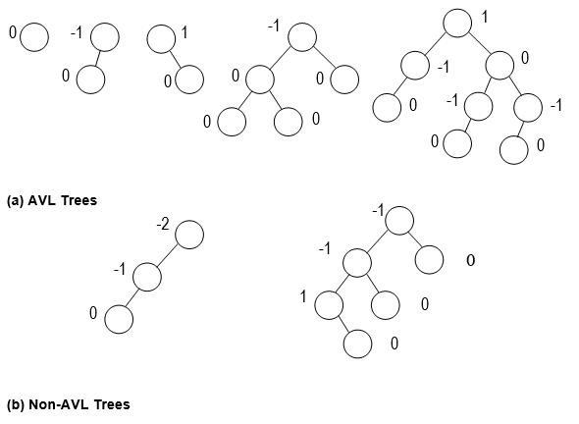
Example
Each node in an AVL tree can have the balance factor as 1, 0, or -1
-2
-2

Slide 7
AVL Tree Construction/Insertion
Step-1: AddTree(x) // Insert the key x into an // ordinary binary tree.
Step-2: Starting from the new node, find the balance factor for each node up to the root node.
Step-3: Repeat the process of checking until the root node is encountered with no node having the balance factor other than 1, 0, or -1, or until the first node where there is an imbalance detected.
Step-4: If an imbalance is detected, then perform single or double rotation.

Slide 8
Rotations
When you have found an imbalance at node x, say, then if the two nodes below the node x and the new node all in a straight line, you require a single rotation.
In case, if these three nodes are in a dog-leg shape (that is, there is a bend in the path), then you require a double rotation.

Slide 9
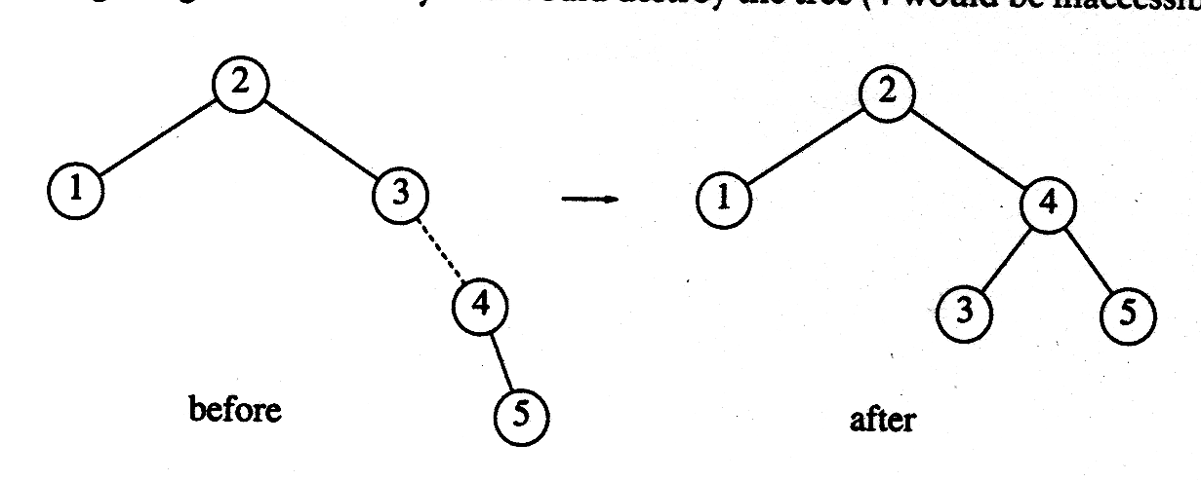
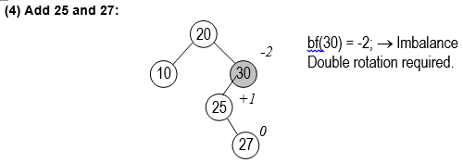
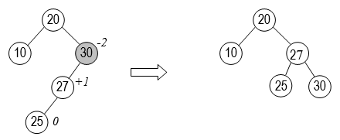
Contd…
Single Rotation
Double Rotation

Slide 10
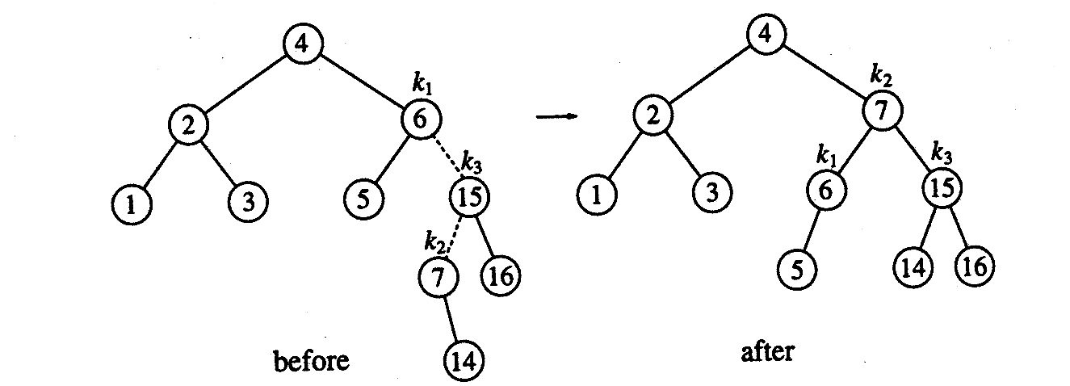
Contd…
Double Rotation

Slide 11
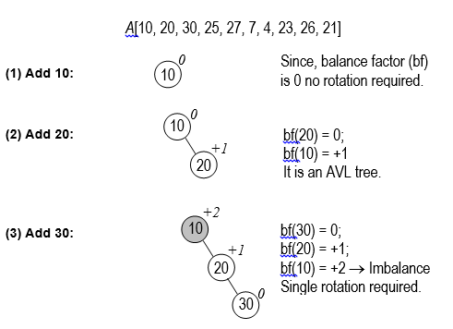
Example

Slide 12
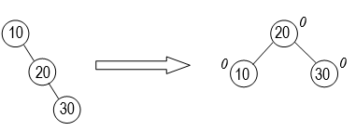
Contd…

Slide 13
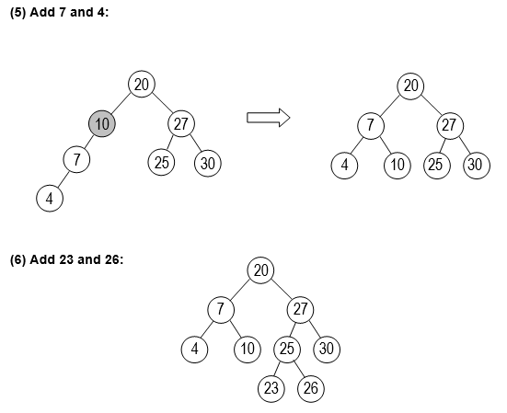
Contd…

Slide 14
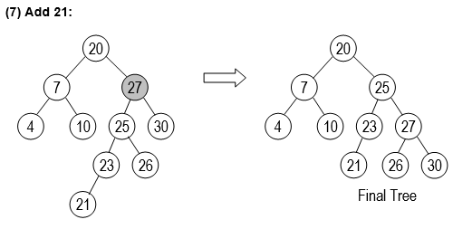
Contd…

Slide 15
Removal in an AVL Tree
Removal begins as in a binary search tree, which means the node removed will become an empty external node. Its parent, w, may cause an imbalance.
Example:
44
44
17
62
17
62
32
50
78
50
78
48
54
88
48
54
88
before deletion of 32
after deletion

Slide 16
Rebalancing after a Removal
Let z be the first unbalanced node encountered while travelling up the tree from w. Also, let y be the child of z with the larger height, and let x be the child of y with the larger height.
We perform restructure(x) to restore balance at z.
As this restructuring may upset the balance of another node higher in the tree, we must continue checking for balance until the root of T is reached
62
a=z
44
Single rotation
44
78
w
17
62
b=y
17
50
88
50
78
c=x
48
54
48
54
88

Slide 17
AVL Trees – Deletion – Eg. 2
13
9
15
Delete 13
6
12
14
20
2
11
18
30
14
14
9
15
9
20
6
12
20
6
12
15
30
2
11
18
30
2
11
18

Slide 18
Running Times for AVL Trees
a single restructure is O(1)
using a linked-structure binary tree
find is O(log n)
height of tree is O(log n), no restructures needed
insert is O(log n)
initial find is O(log n)
Restructuring up the tree, maintaining heights is O(log n)
remove is O(log n)
initial find is O(log n)
Restructuring up the tree, maintaining heights is O(log n)

Slide 19
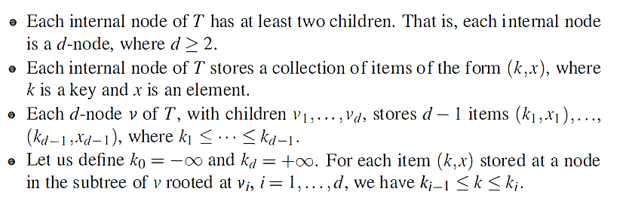
Multi-Way Search Trees
Trees with internal nodes that have two or more children.
Let v be a node of an ordered tree. We say that v is a d-node if v has d children. We define a multi-way search tree to be an ordered tree T that has the following properties:

Slide 20
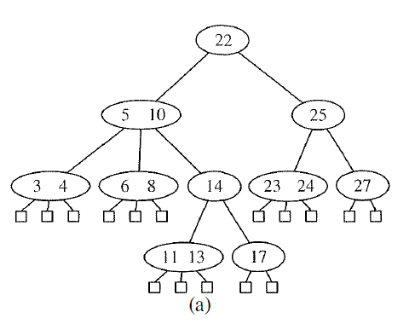
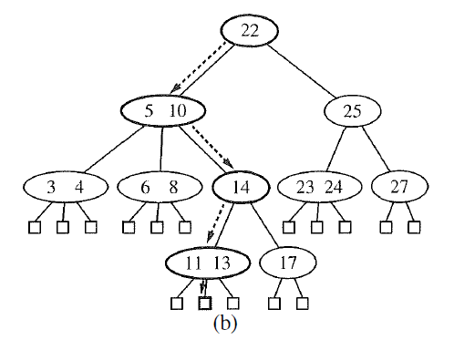
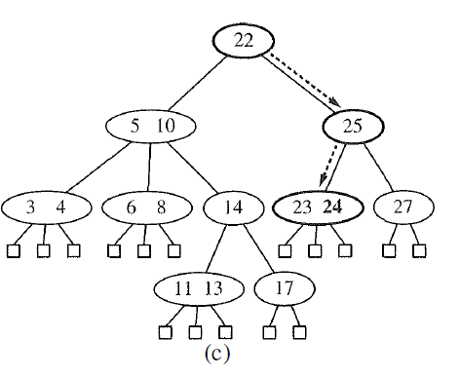
Example
Key = 12
Key = 24

Slide 21
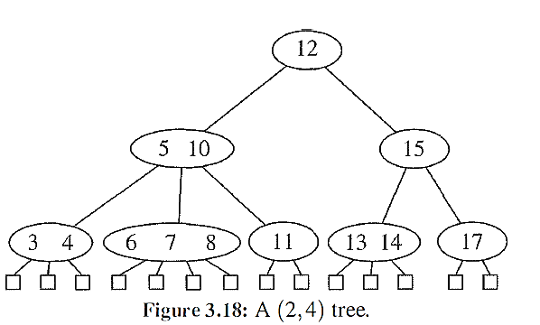
(2,4) Trees
It is also called as (2,3,4) Tree
we can maintain balance in a (2, 4) tree by maintaining two simple properties
Size Property : Every node has at most four children.
Depth Property : All the external nodes have the same depth.
The height of a (2, 4) tree storing
n items is Θ(log n)

Slide 22
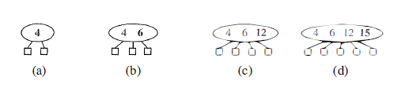
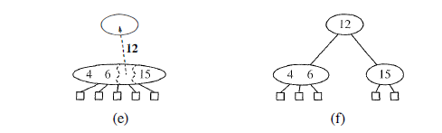
Insertion in a (2,4) Tree

Slide 23
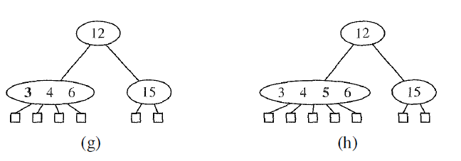
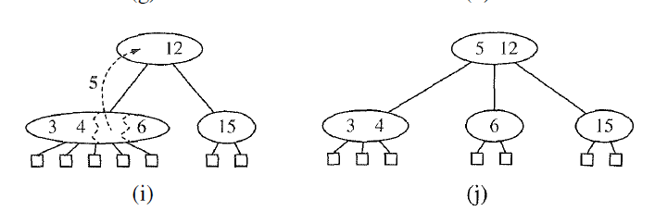
Contd.

Slide 24
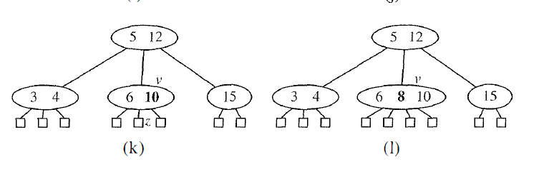
Contd.

Slide 25
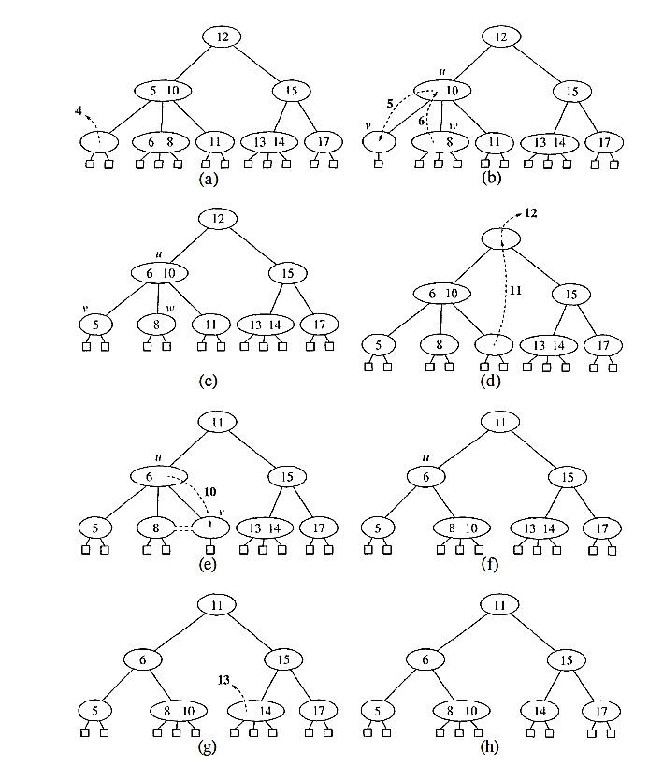
Removal in (2,4) Trees

Slide 26
Removal in (2,4) Trees

Slide 27
Performance
The height of a (2, 4) tree storing n items is O(log n),
A split, transfer, or fusion operation takes O(1) time.
A search, insertion, or removal of an item visits O(log n) nodes.

Slide 28
Thank You

